Slide 1


Flight Path
AI-Powered Assessment and Personalized Recommendation
By: Group 10 - WASD

Slide 2
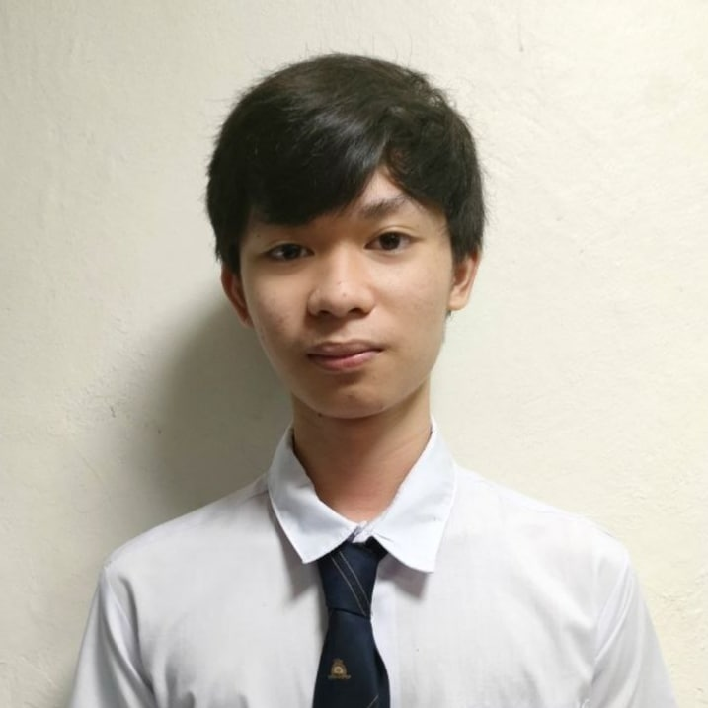
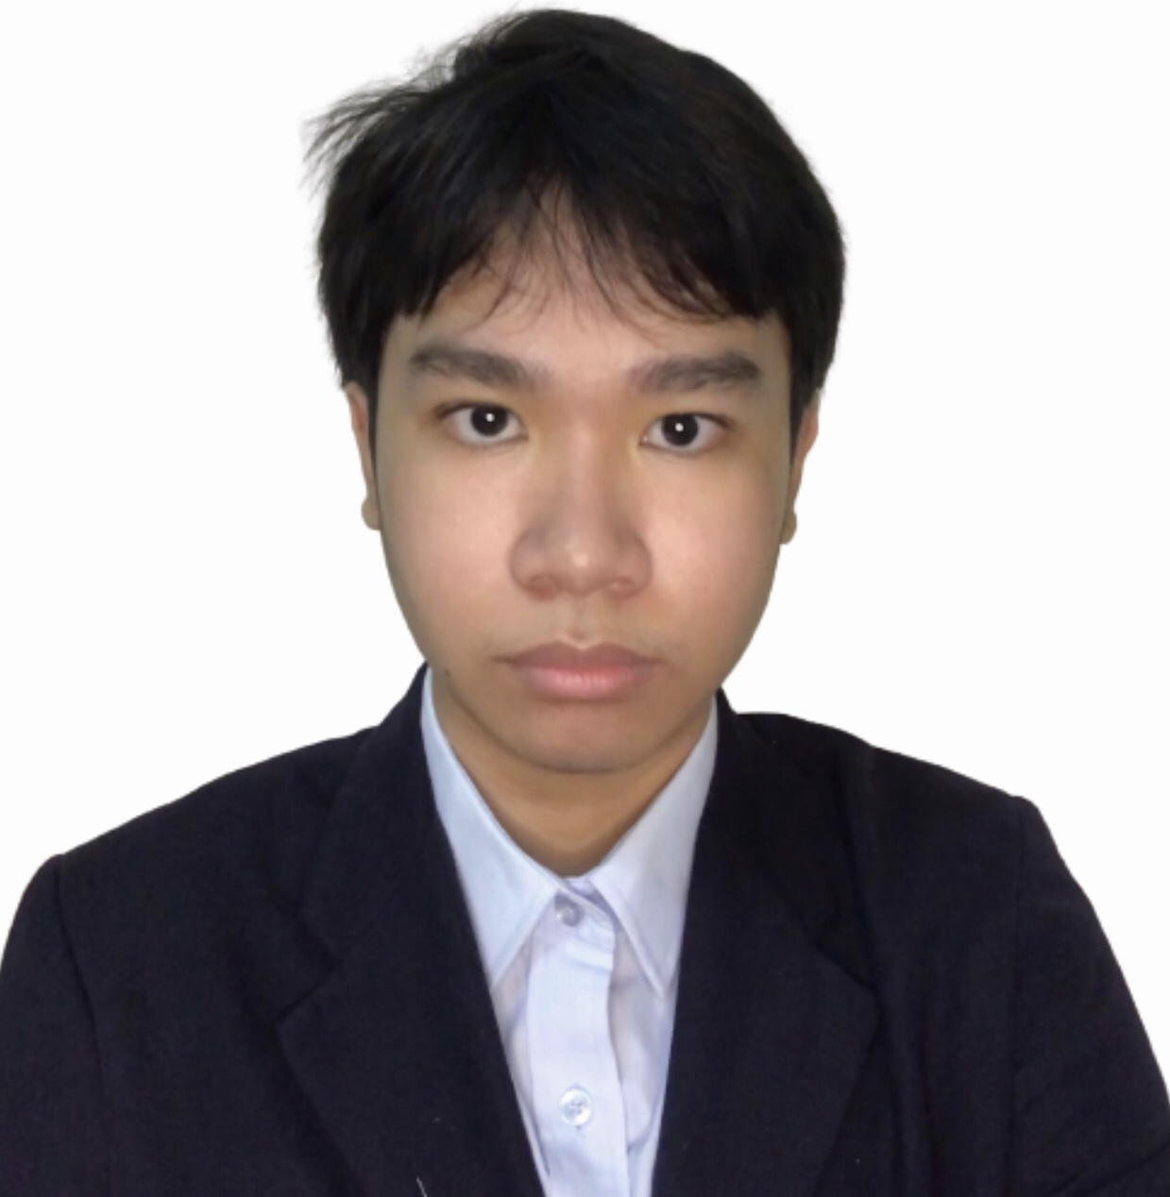
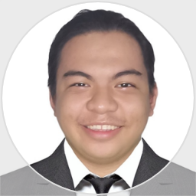
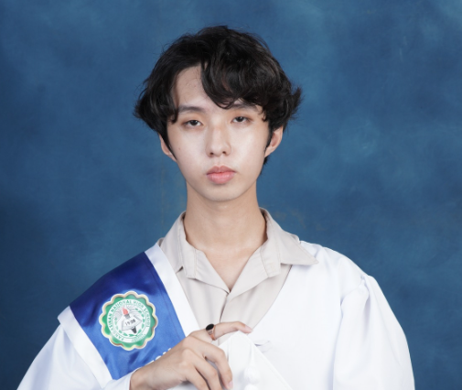
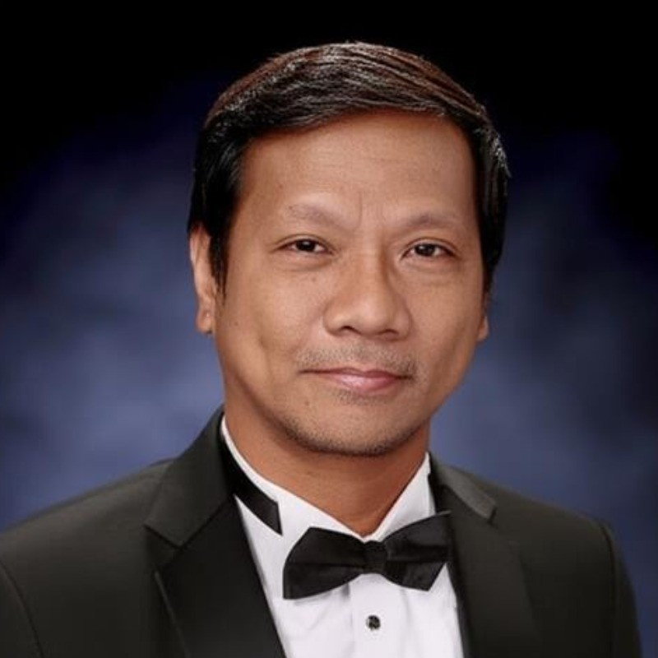
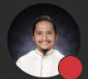
Our Team
Andrei Luis Torres
Justin Bryden Arroco
Don Victor Idos
John Michael Maala
Scrum Master, Project Leader, Developer
Product Assistant, Developer
Product Owner, Developer
Secretary, Developer
Felino Calderon
Manuel L. Calimlim, Jr.
Project Adviser
Project Consultant

Slide 3
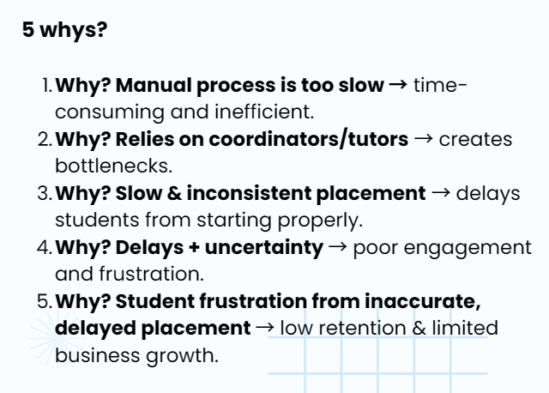
Midterm Output Comments Matrix
Andrei Luis Torres
Root Cause Analysis (Connect the reasons to one another)
MIDTERMS
Problem: UpsWing! Needs to automate its assessment process.
Why 1: The process is slow
Why 2: Because it is done manually
Why 3: Because admins and tutors must handle each assessment by hand and they cannot keep up with the number of new request.
Why 4 (Root Cause): Because is no existing automated system in place to support or replace the manual work

Slide 4
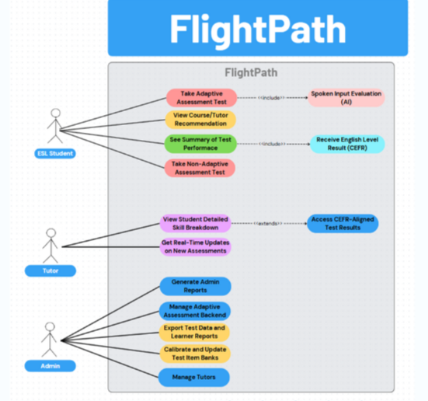
Midterm Output Comments Matrix
Use Case Diagram
MIDTERMS
Andrei Luis Torres

Slide 5
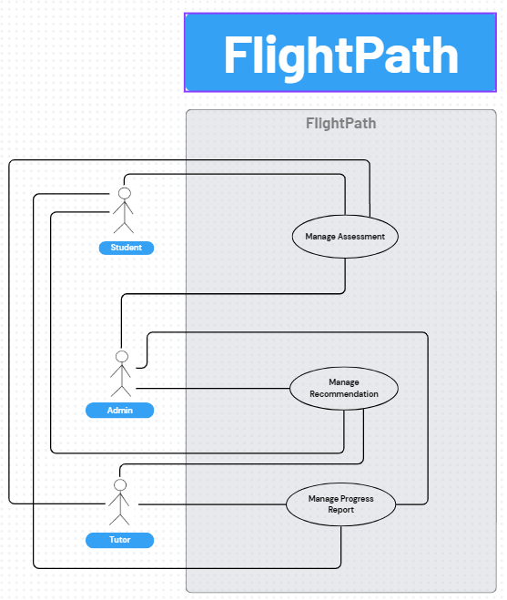
Midterm Output Comments Matrix
Use Case Diagram
Andrei Luis Torres
https://www.canva.com/design/DAGmLZtkIPY/UajwBW4RII09Sm0nQKnV0g/edit

Slide 6
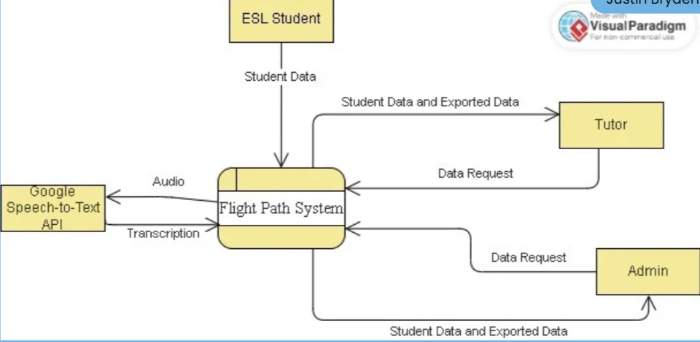
Midterm Output Comments Matrix
Don Victor Idos
Midterms DFD
Level 0

Slide 7
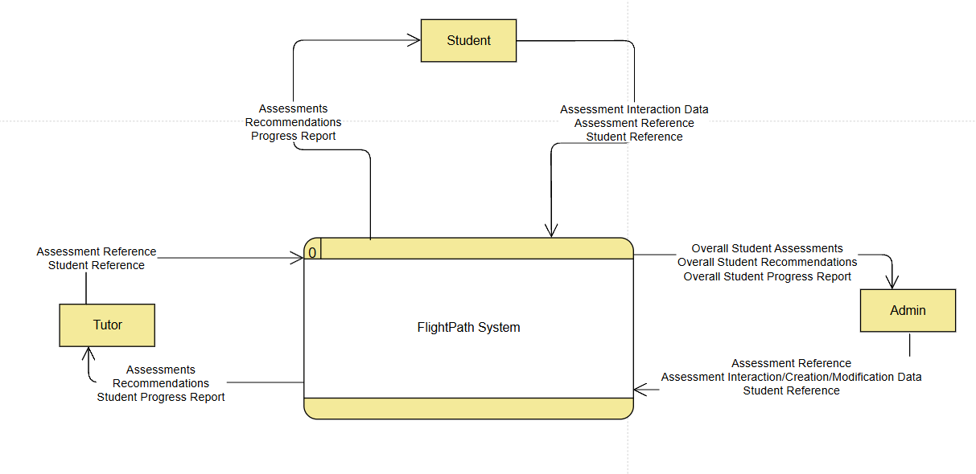
DFD Level 0
Don Victor Idos

Slide 8
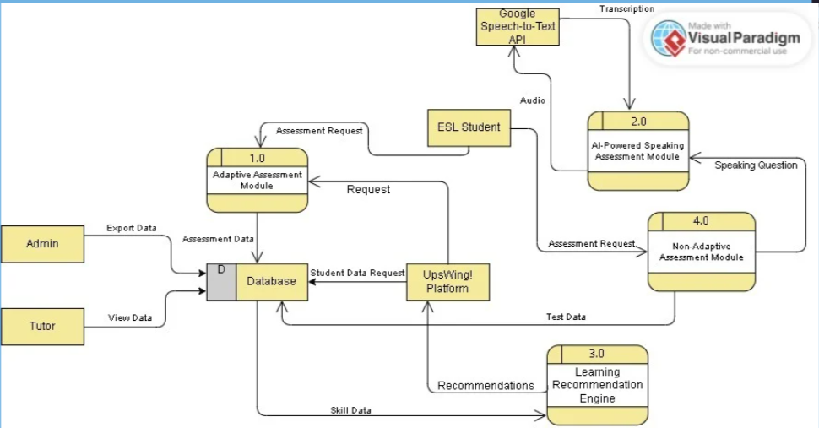
Midterm Output Comments Matrix
Don Victor Idos
Midterms DFD
Level 1

Slide 9
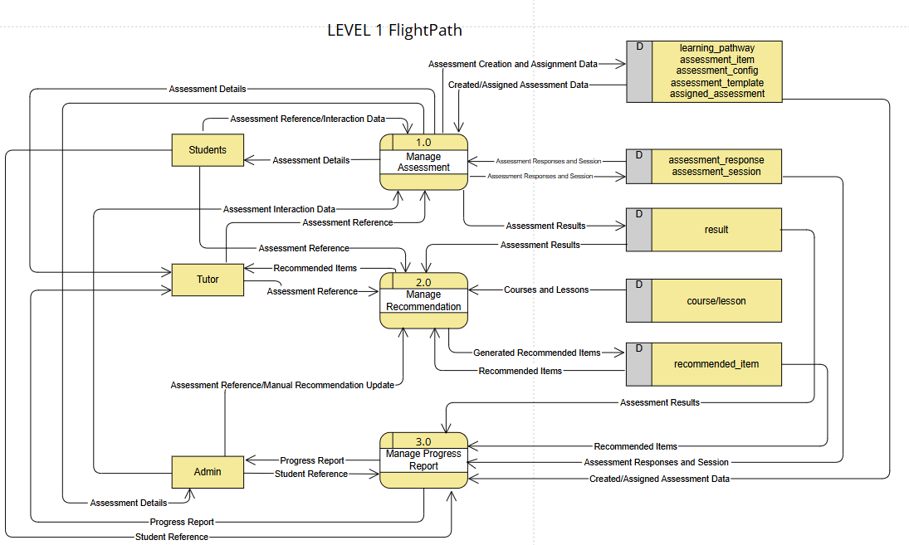
DFD Level 1
Don Victor Idos

Slide 10
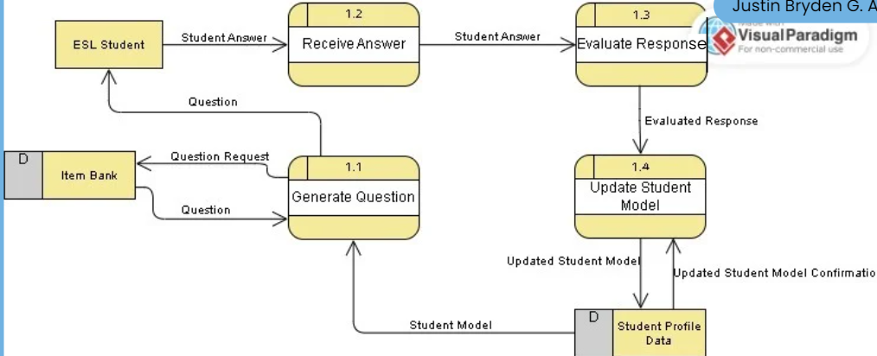
Midterm Output Comments Matrix
Don Victor Idos
Midterms DFD
Level 2

Slide 11
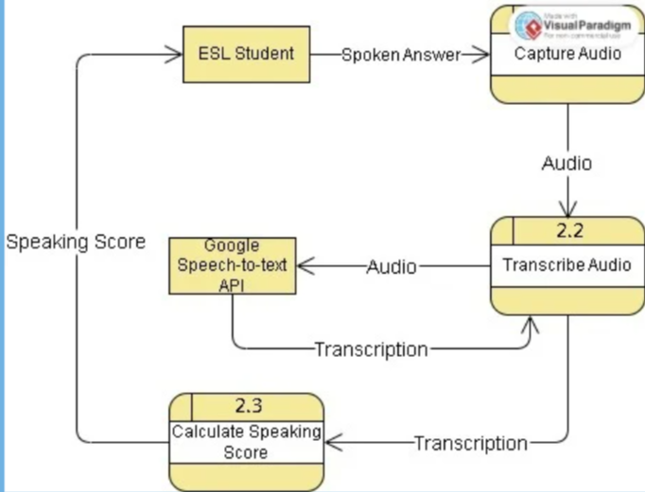
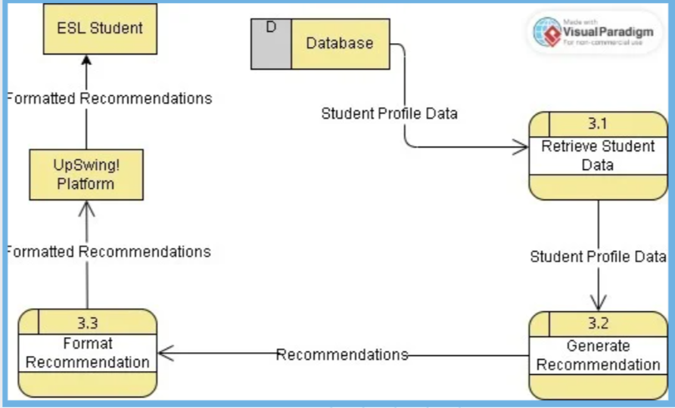
Midterm Output Comments Matrix
Don Victor Idos
Midterms DFD
Level 2

Slide 12
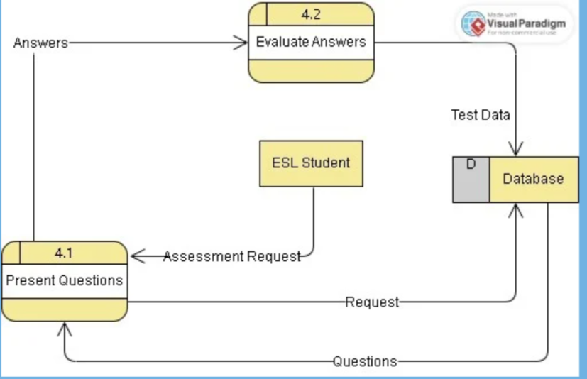
Midterm Output Comments Matrix
Don Victor Idos
Midterms DFD
Level 2

Slide 13
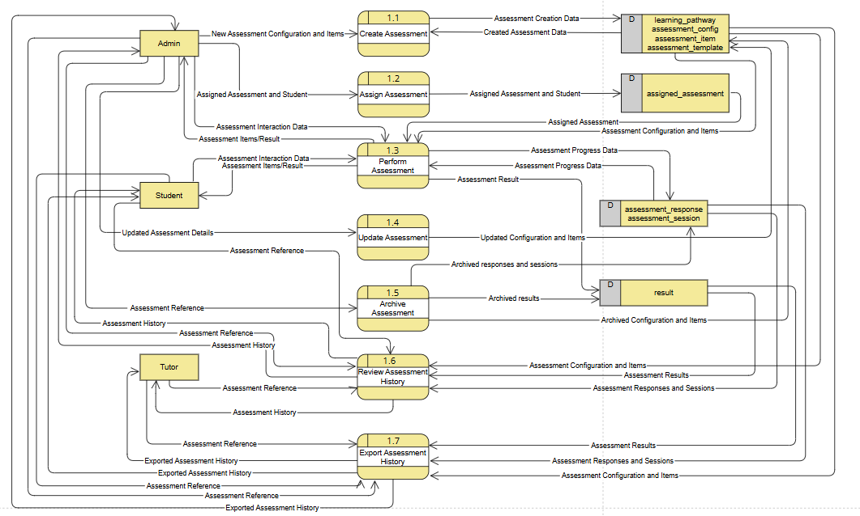
DFD Level 2 – 1.0
Don Victor Idos

Slide 14
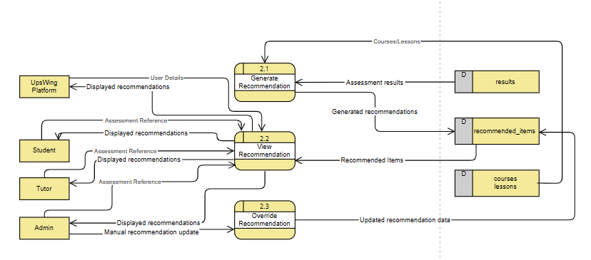
DFD Level 2 – 2.0
JUSTIN BRYDEN ARROCO

Slide 15
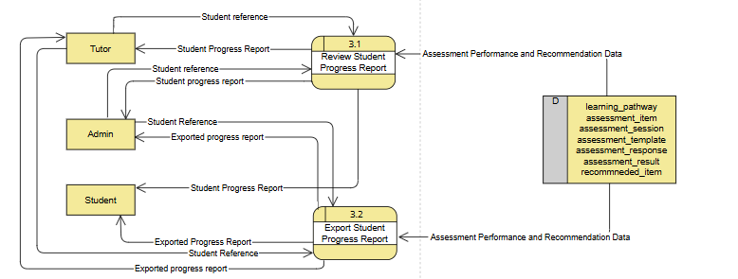
DFD Level 2 – 3.0
JUSTIN BRYDEN ARROCO

Slide 16
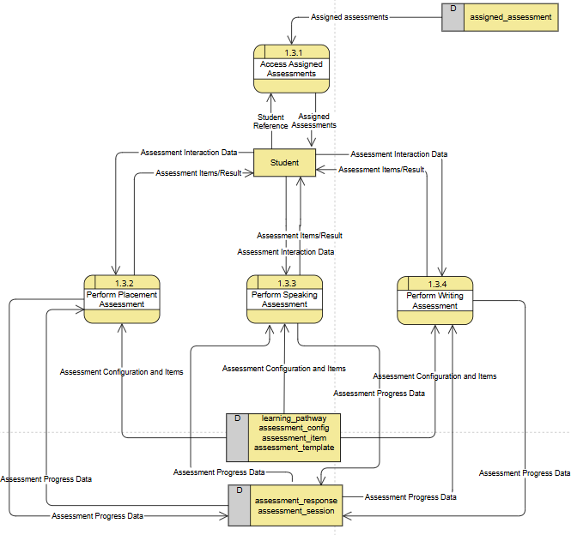
DFD Level 3 – 1.3.x:
JUSTIN BRYDEN ARROCO

Slide 17
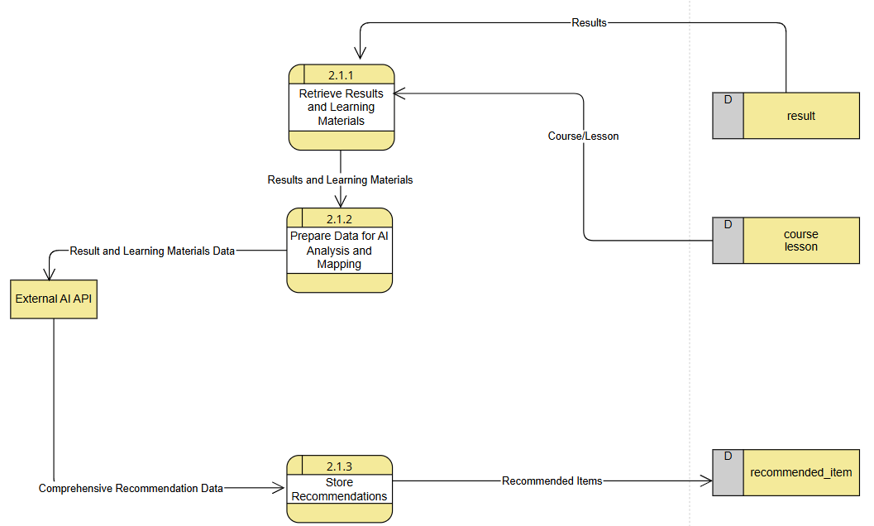
DFD Level 3 – 2.1.x:
JUSTIN BRYDEN ARROCO

Slide 18
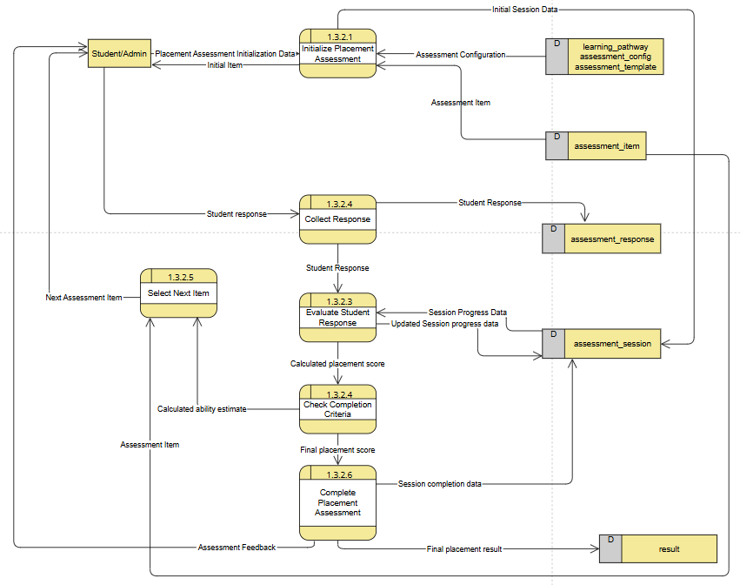

DFD Level 4 – 1.3.2.x
JUSTIN BRYDEN ARROCO

Slide 19
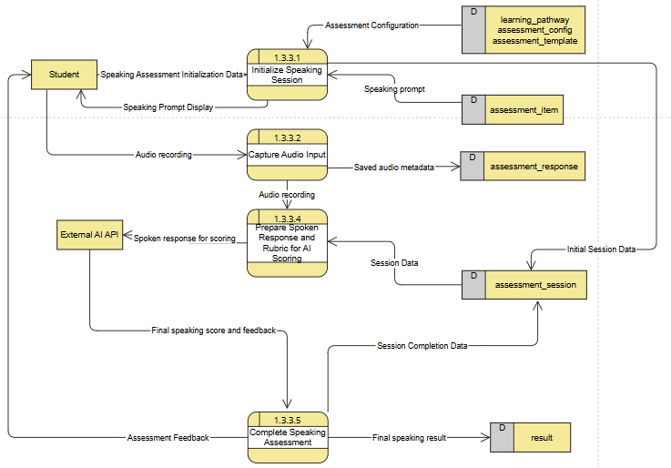
DFD Level 4 – 1.3.3.x
JUSTIN BRYDEN ARROCO

Slide 20
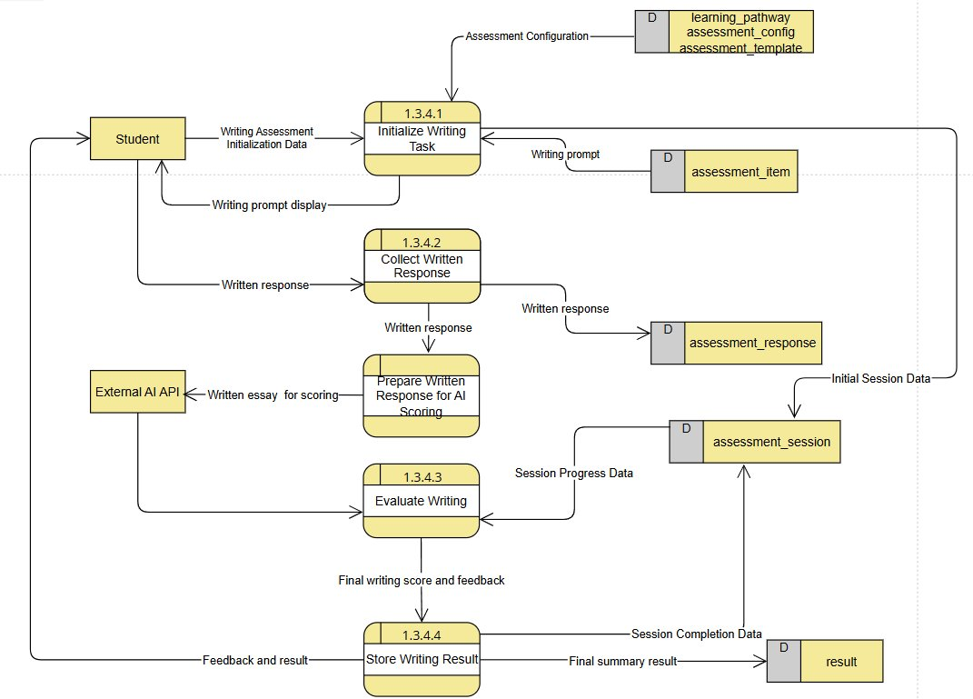
DFD Level 4 – 1.3.4.x
JUSTIN BRYDEN ARROCO

Slide 21
DFD LINK
JUSTIN BRYDEN ARROCO
https://online.visual-paradigm.com/w/efmbgigt/app/diagrams/#diagram:workspace=efmbgigt&proj=0&id=4&workspace=efmbgigt&type=DataFlowDiagram?themeSketch=1

Slide 22
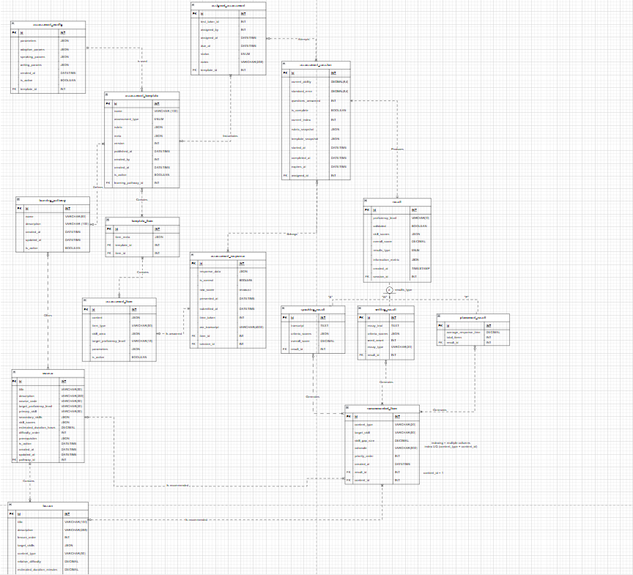
ERD
Don Victor Idos
ERD v2.drawio - Google Drive

Slide 23
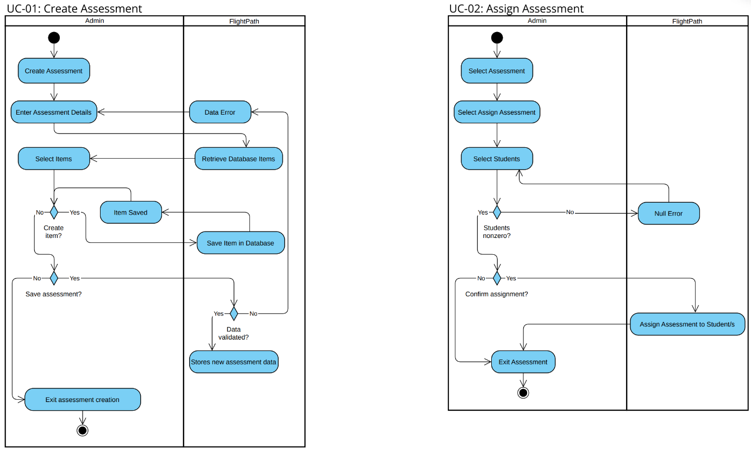
Activity Diagram
JOHN MICHAEL MAALA
Activity Swimlanes Diagram.pdf

Slide 24
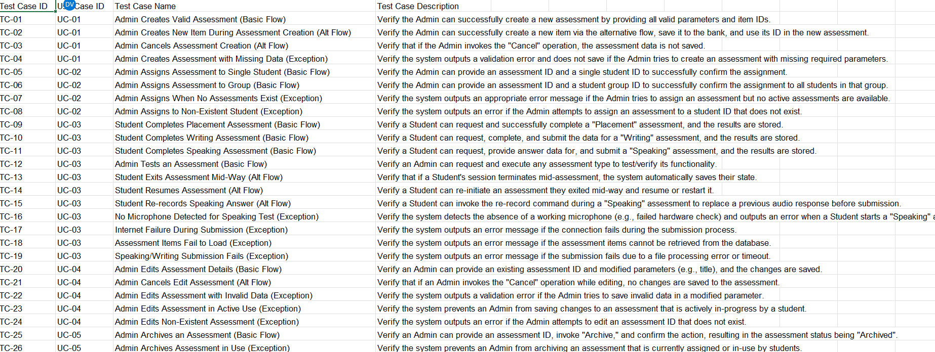
Updated Test Cases
JOHN MICHAEL MAALA
Test Case Table.xlsx

Slide 25



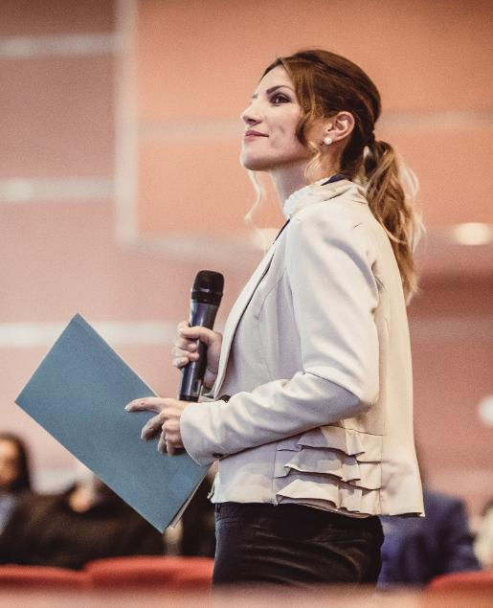
Demo of our Backend
JOHN MICHAEL MAALA

Slide 26
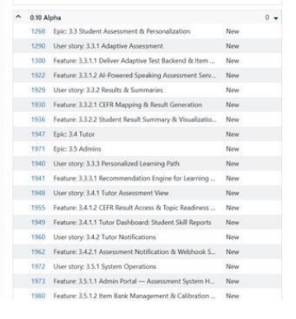
Agile Scrum Sprint 1 Ceremonies: Sprint Planning
Andrei Luis Torres
Assigned Product Owner: Don Victor Idos
Assigned Scrum Master: Andrei Luis Torres
Initial Backlog

Slide 27
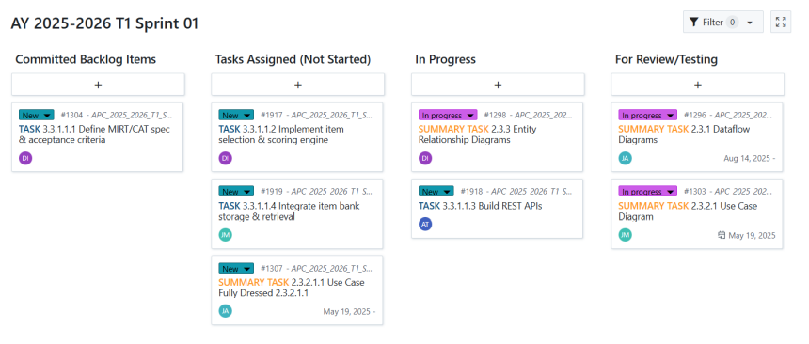
Agile Scrum Sprint 1 Ceremonies: Sprint Planning
Andrei Luis Torres

Slide 28
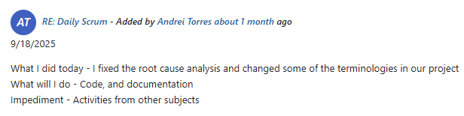
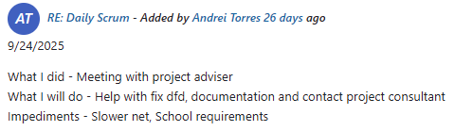
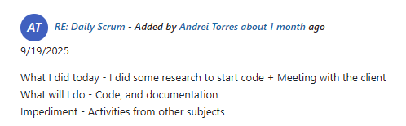
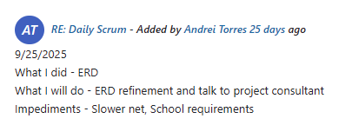
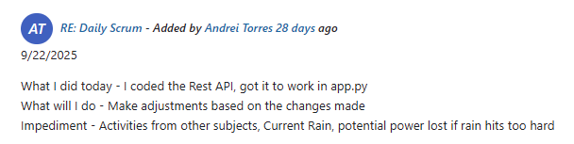
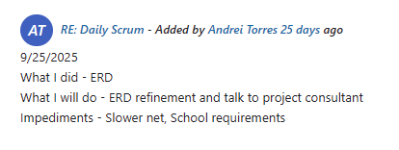
Agile Scrum Sprint 1 Ceremonies: Daily Standup Summary
Andrei Luis Torres

Slide 29
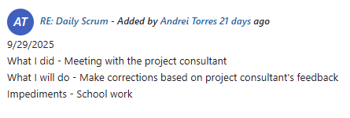
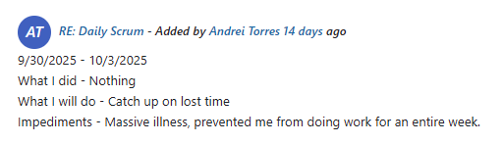
Agile Scrum Sprint 1 Ceremonies: Daily Standup Summary
Andrei Luis Torres

Slide 30
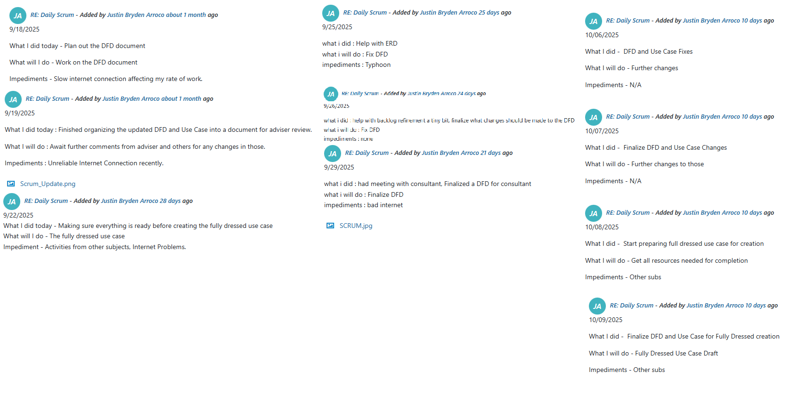
Agile Scrum Sprint 1 Ceremonies: Daily Standup Summary
JUSTIN BRYDEN ARROCO

Slide 31
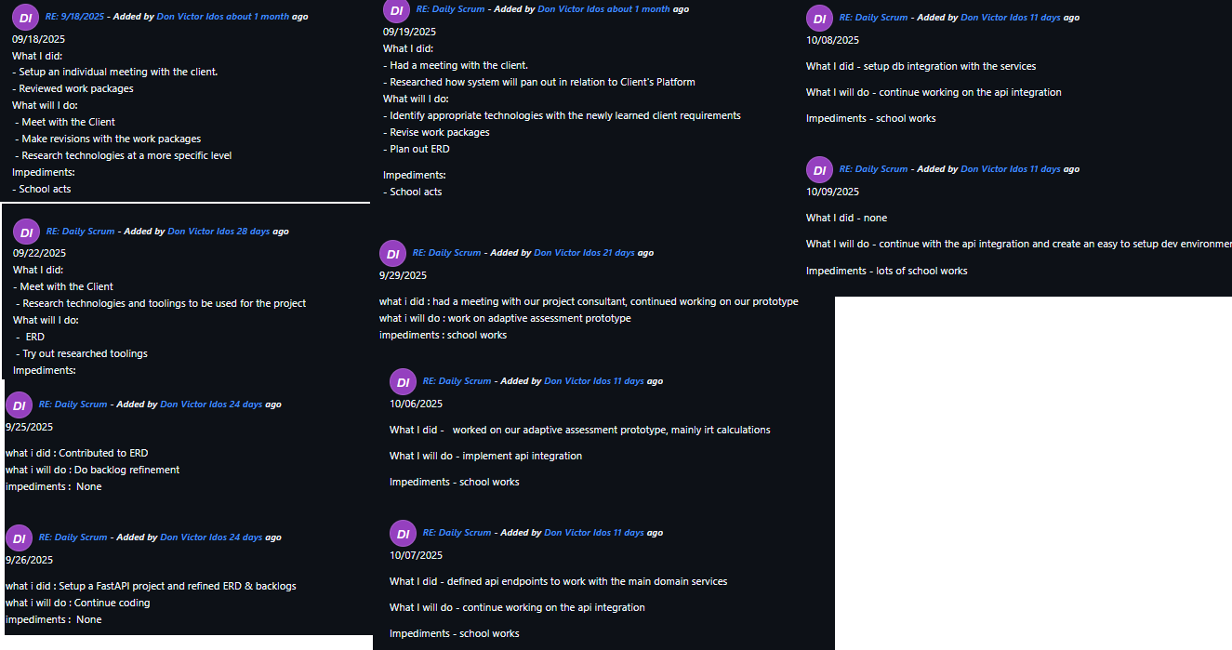
Agile Scrum Sprint 1 Ceremonies: Daily Standup Summary
Don Victor Idos

Slide 32
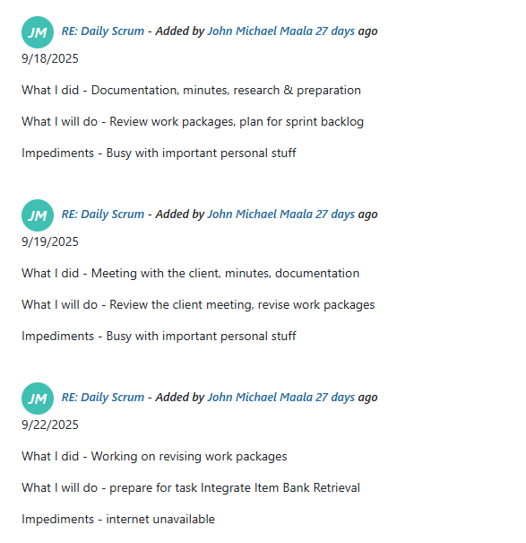
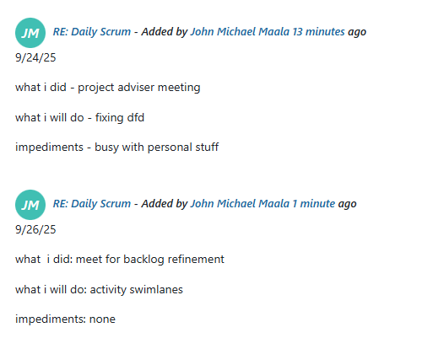
Agile Scrum Sprint 1 Ceremonies: Daily Standup Summary
JOHN MICHAEL MAALA

Slide 33
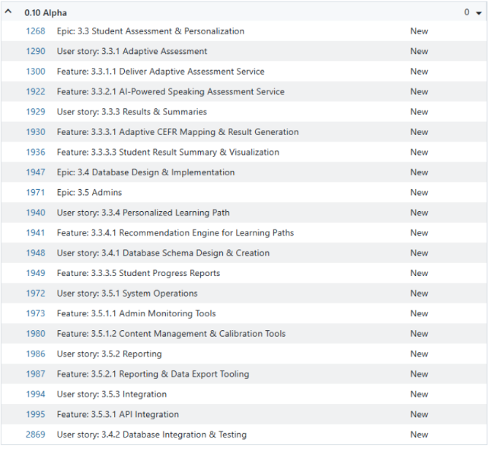
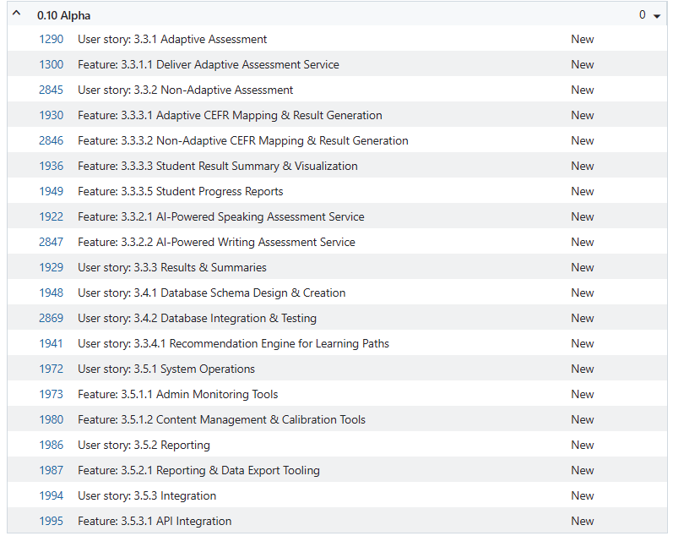
Agile Scrum Sprint 1 Ceremonies: Backlog Refinement
Andrei Luis Torres
Initial
Updated Backlog

Slide 34
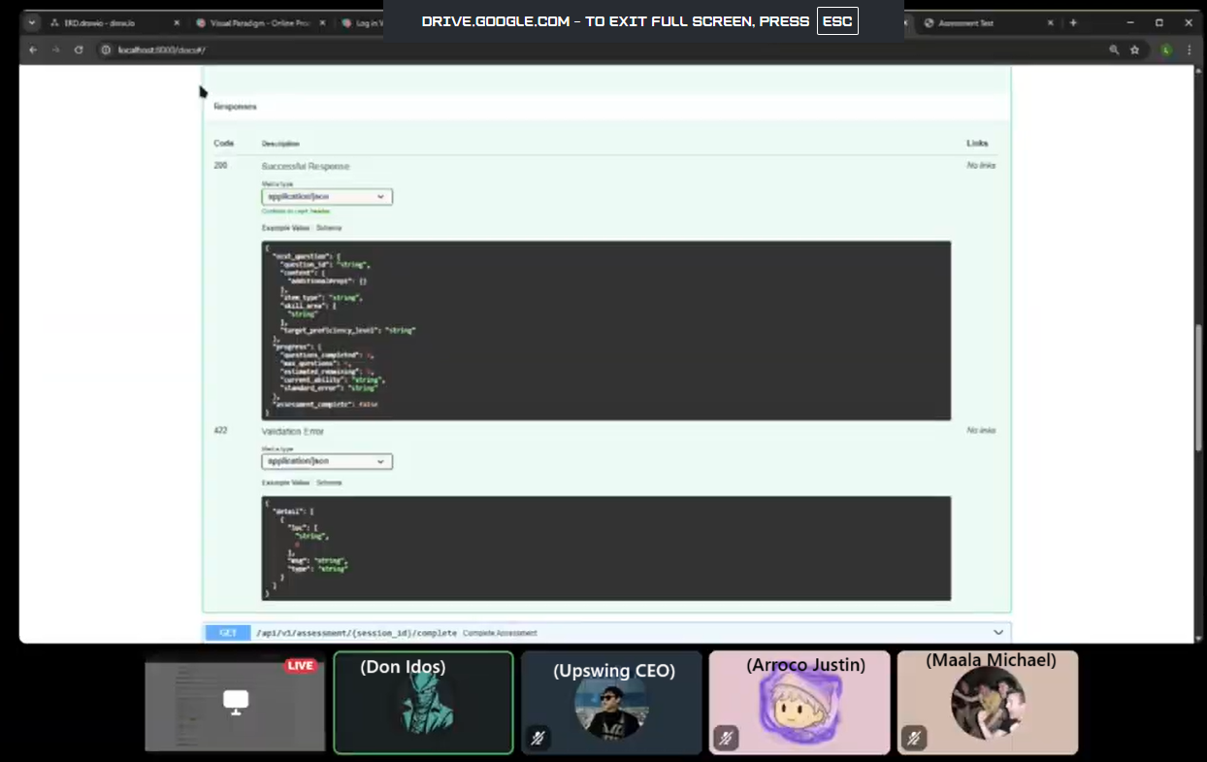
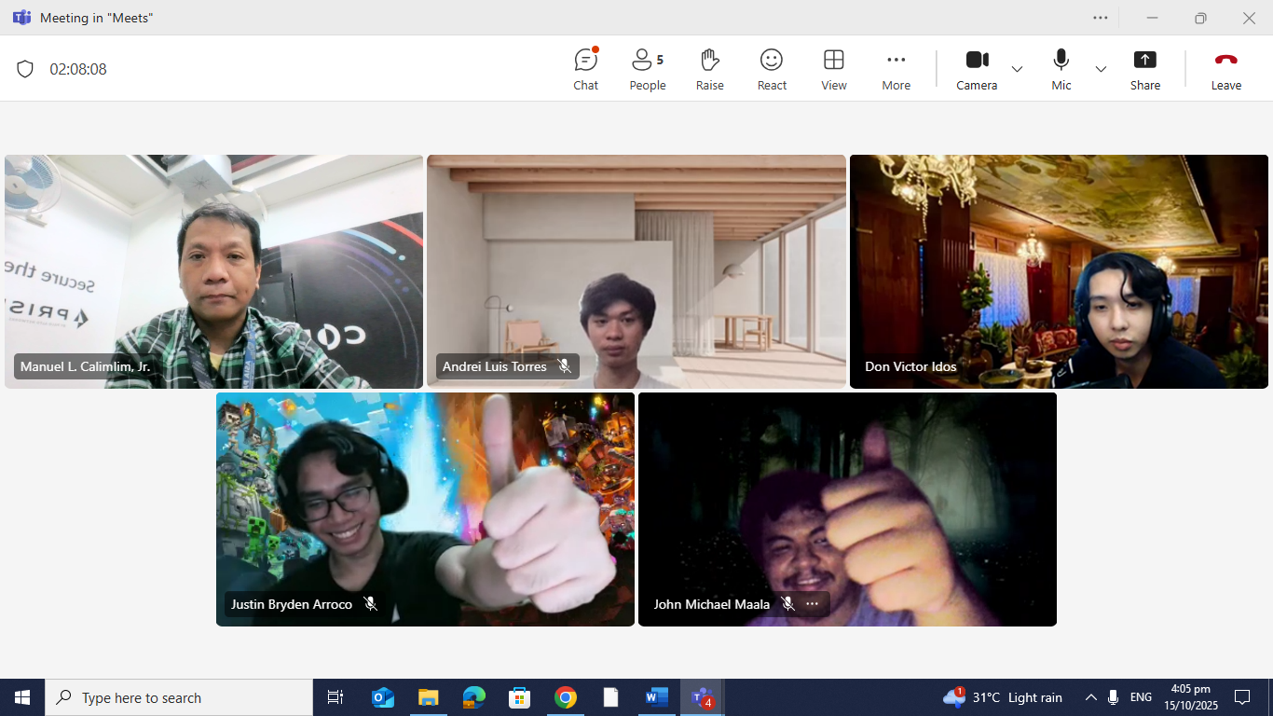
Agile Scrum Sprint 1 Ceremonies: Sprint Review
Andrei Luis Torres

Slide 35
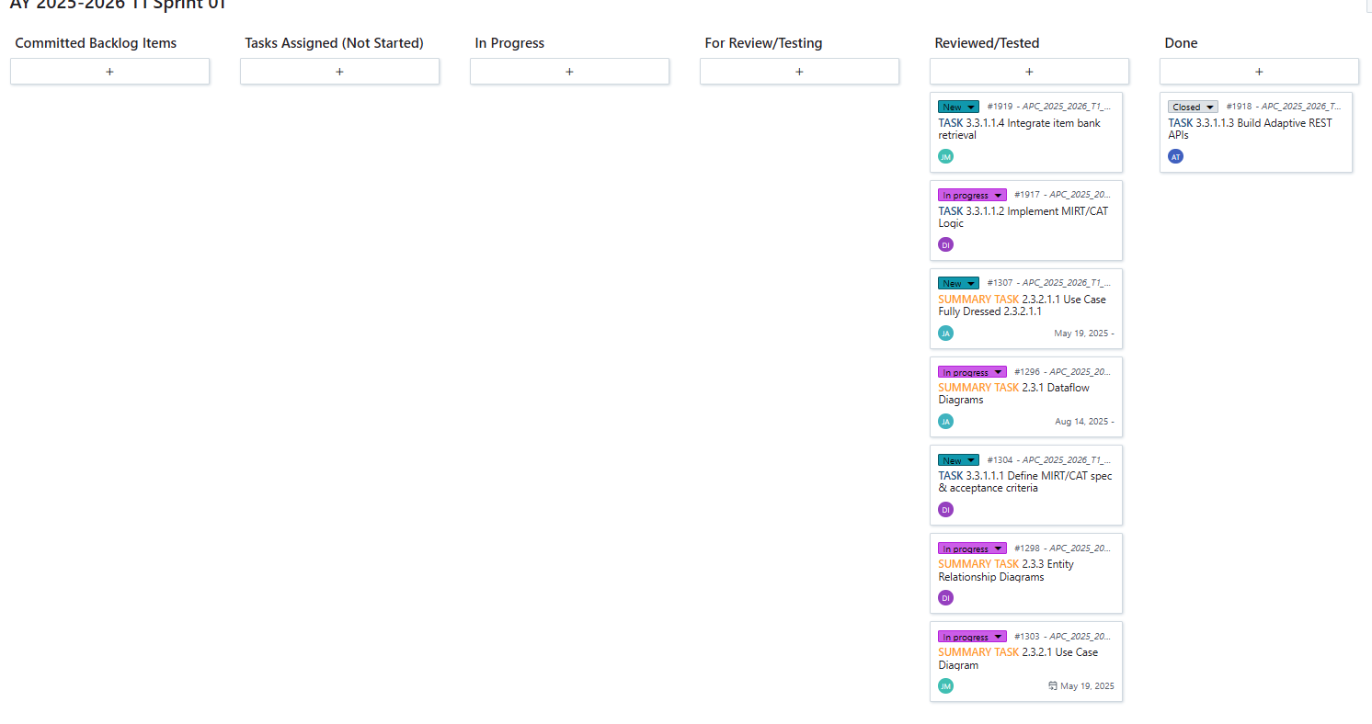
Agile Scrum Sprint 1 Ceremonies: Sprint Review
Andrei Luis Torres

Slide 36
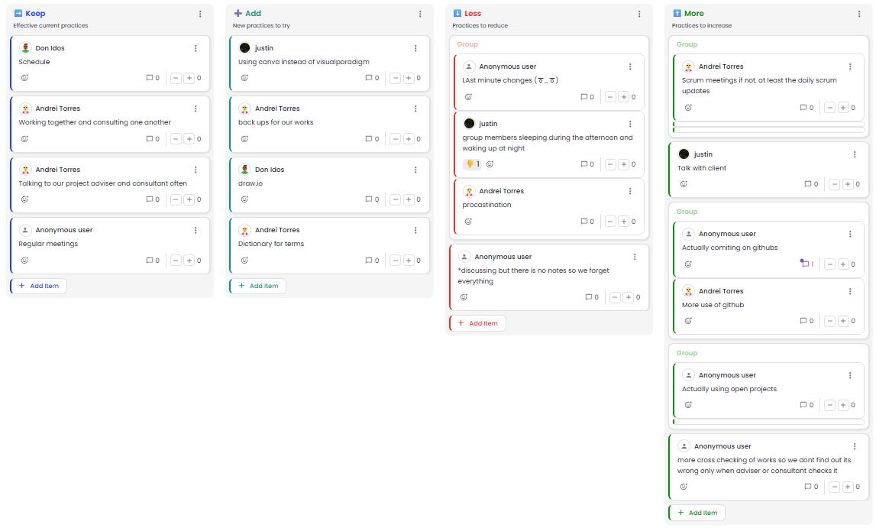
Agile Scrum Sprint 1 Ceremonies: Retrospective
Andrei Luis Torres

Slide 37
Agile Scrum Sprint 1 Ceremonies: Retrospective
Andrei Luis Torres
Actionable Items:
Add:
Decide on Canva vs Draw.io
Add AI for meetings
Make dictionary of terms
Less:
Work more, do not procrastinate
Notes when discussing things especially with disagreement. AI tool to probably help with that
Set Schedules for working
More:
Daily Scrum Updates
Bi-weekly meeting with the clients
Start using GitHub and OpenProject more seriously
Cross check each others work

Slide 38
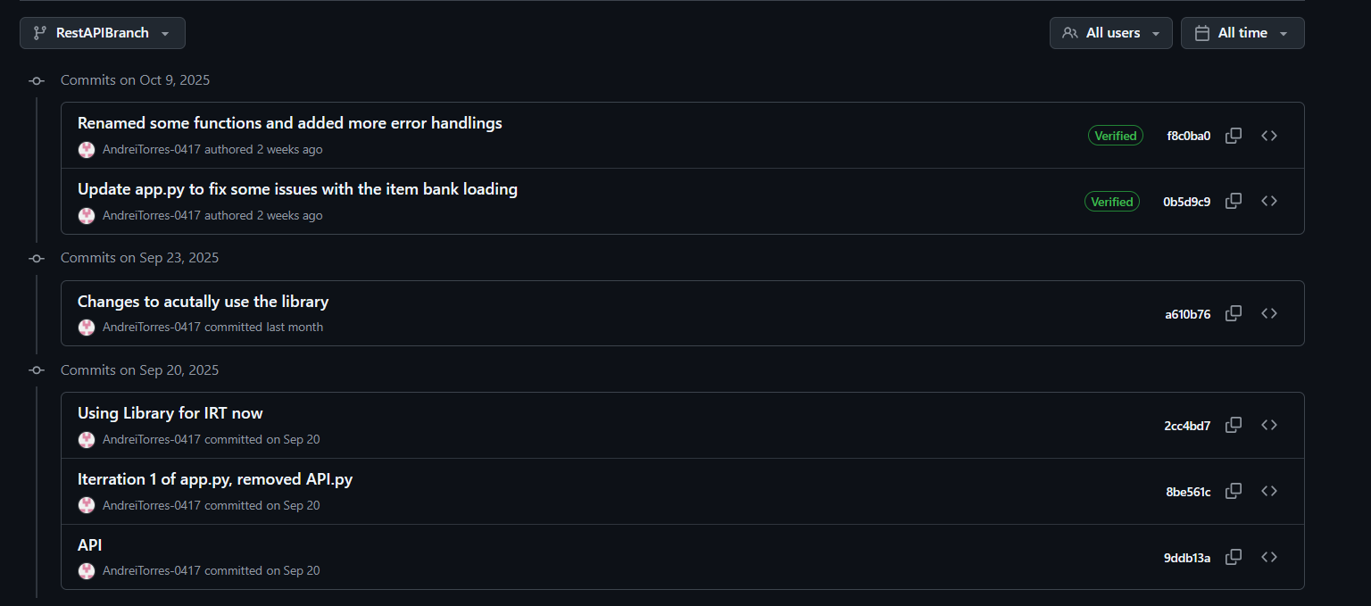
Github Commit History
Andrei Luis Torres

Slide 39

Github Commit History
Andrei Luis Torres

Slide 40
Github Commit History
Andrei Luis Torres

